Slide 1
The 8087 math coprocessor

Slide 2
8087 Data Types
3 Types
1. Binary integer
2. Packed Decimal
3. Real

Slide 3
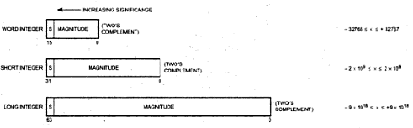
Binary Integers
Assembler Directive
Word integer→16 bits→DW(Define Word)
Short integer→ 32 bits→DD(Define DoubleWord)
Long Integer→ 64 bits→DQ(Define Quadword)

Slide 4
Packed Decimal Numbers
Assembler Directive
Packed Decimal→80 bits→DT(Define TenBytes)

Slide 5
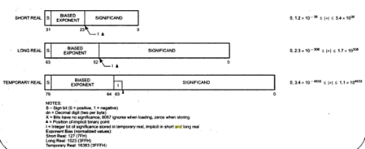
Real Numbers
Assembler Directive
Short real→32 bits→DD(Define DoubleWord)
Long Real→ 64 bits→DD(Define QuadWord)
Temporary Real→ 80 bits→DT(Define TenBytes)

Slide 6
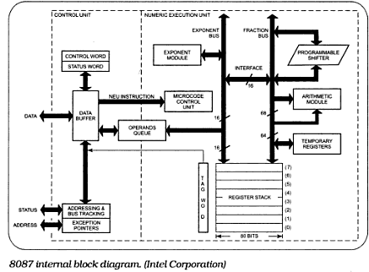
The 8087 Internal Architecture

Slide 7
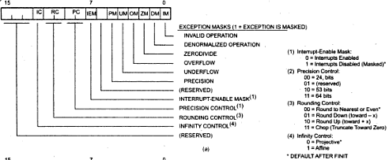
Control word format

Slide 8
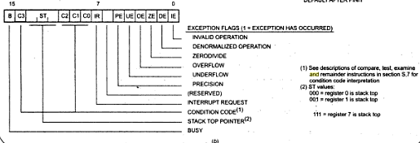
Status word format

Slide 9
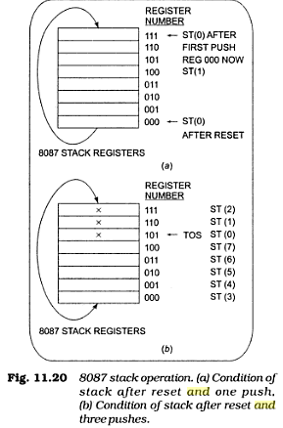
8087 stack operation

Slide 10
Pythagoras Theorem
Data segment word public
Side_a dd 3.0
Side_b dd 4.0
Result dd 0
Ctrl_word dw 0
Status_word dw 0
Data ends
Code segment word puplic
Assume cs: code, ds:data
Start: mov ax,data
mov ds,ax
FINIT
mov ctrl_word,03ffh
FLDCW ctrl_word
FLD side_a
FMUL ST,ST(0)
FLD side_b
FMUL ST,ST(0)
FADD St,ST(1)
FSQRT
FSTSW status_word
Mov ax,status_word
AND al,0BFH
JNZ stop
FSTP result
Stop: NOP
Code ends
End start

